Slide 1

CSE 2218: Data Structures and Algorithms II Laboratory
Sherajul Arifin
Lecturer, Department of Computer Science and Engineering,
United International University

Slide 2
Shortest Path Algorithms

Slide 3
Single Source Shortest Path
Given a graph (directed or undirected) G = (V, E) with weight function w: E → R and a vertex s ∈ V, find for all vertices v ∈ V the minimum possible weight for path from s to v.
We will discuss two general case algorithms:
Dijkstra's Algorithm (positive edge weights only)
Bellman-Ford Algorithm (positive and negative edge weights)
If all edge weights are equal (let's say 1), the problem is solved by BFS in Θ(V + E) time.

Slide 4
Dijkstra’s Algorithm
Greedy algorithm: always expand the node with the smallest known distance.
Uses a priority queue (min-heap) for efficiency.
Steps:
Initialize dist[] with ∞, dist[src] = 0.
Use a min-heap (priority_queue in C++ with custom comparator).
While heap not empty:
  Extract node u with minimum dist[u].
  For each edge (u, v, w): if dist[u] + w < dist[v], update dist[v] and push into heap.

Slide 5
Dijkstra’s Algorithm
Complexity
Each edge may be relaxed once: O(E log V) due to priority queue.
Extracting min happens V times.
Total = O((V + E) log V).

Slide 6
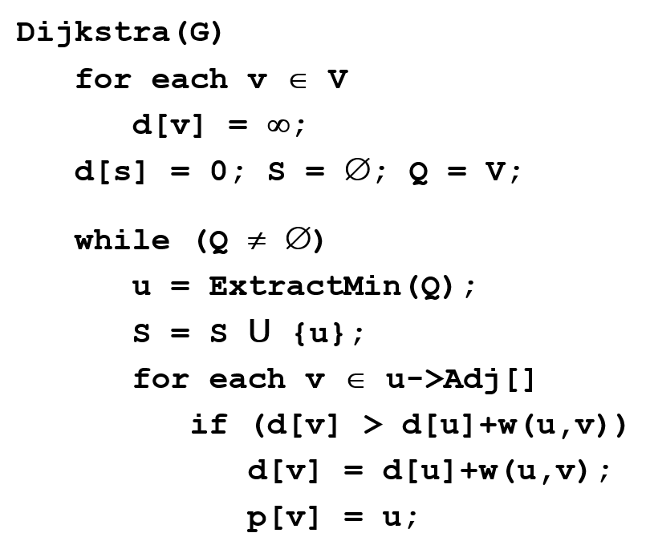
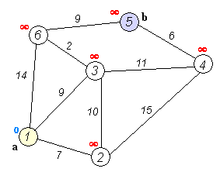
Dijkstra’s Algorithm

Slide 7
Bellman-Ford Algorithm
Dynamic programming approach: Repeatedly relax all edges up to V-1 times (shortest path can have at most V-1 edges).
Detects negative cycles if distances still improve after V-1 relaxations.
Steps
Initialize dist[] with ∞, dist[src] = 0.
Repeat V-1 times:
  For each edge (u, v, w): if dist[u] + w < dist[v], update dist[v].
  Run one more iteration: if any edge relaxes, report a negative cycle.
Complexity
Each iteration checks all E edges.
Runs for V-1 iterations → O(V * E).

Slide 8
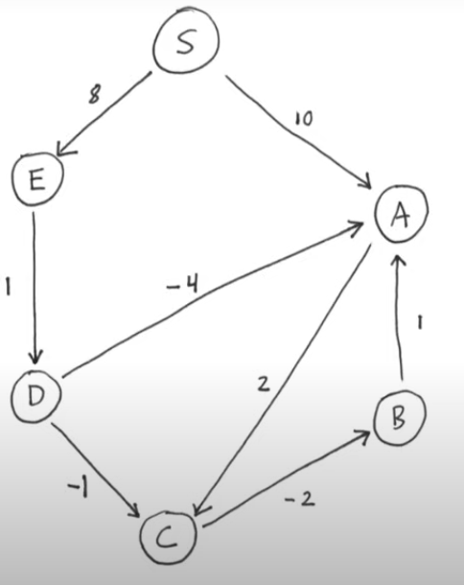

Slide 9
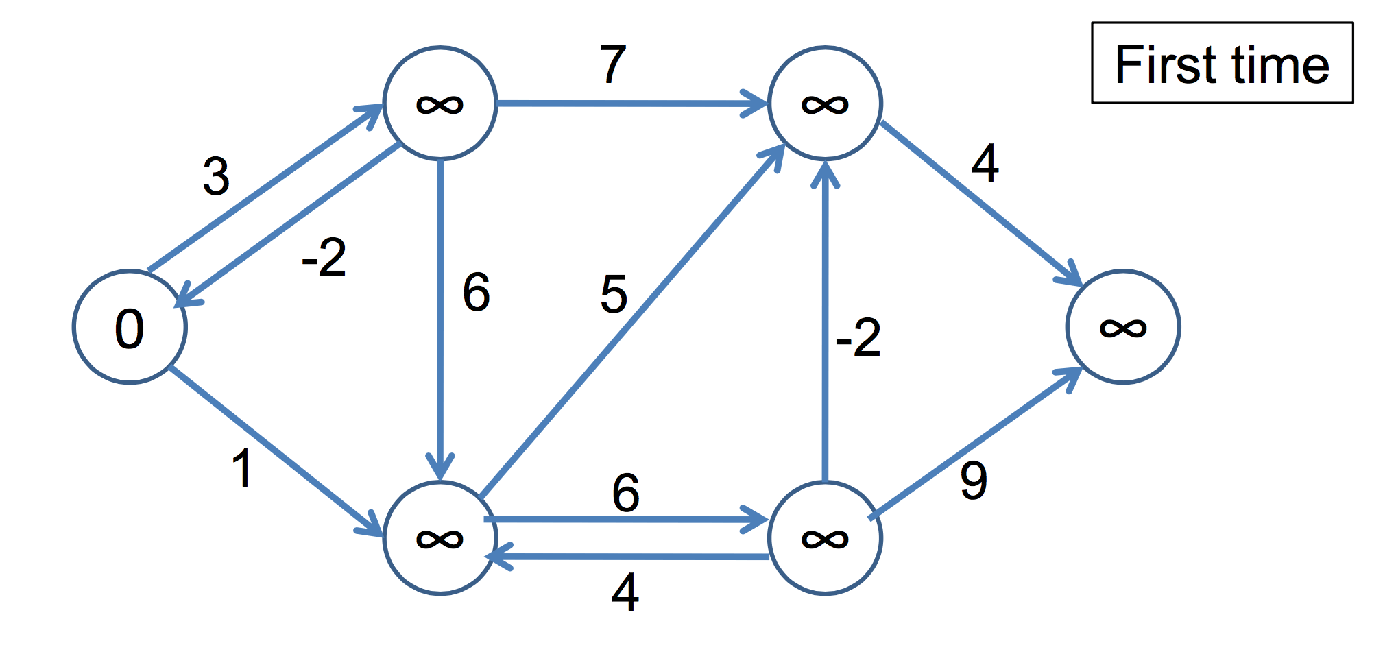
Bellman-Ford Algorithm
BellmanFord()
1 for each v ∈ V
2 d[v] = ∞;
3 d[s] = 0;
4 for i=1 to |V|-1
5 for each edge (u,v) ∈ E
6 Relax(u,v,w);
7 for each edge (u,v) ∈ E
8 if (d[v] > d[u] + w(u,v))
9 return “no solution”;
Relax(u,v,w): if (d[v] > d[u]+w(u,v))
then d[v]=d[u]+w(u,v)

Slide 10
Minimum Spanning Tree

Slide 11
Spanning Tree
A spanning tree is a subset of Graph G, which has all the vertices covered with minimum possible number of edges.
Hence, a spanning tree does not have cycles and it cannot be disconnected. By this definition, we can draw a conclusion that every connected and undirected Graph G has at least one spanning tree.
If there are n vertices in the graph, then each spanning tree has n − 1 edges.

Slide 12
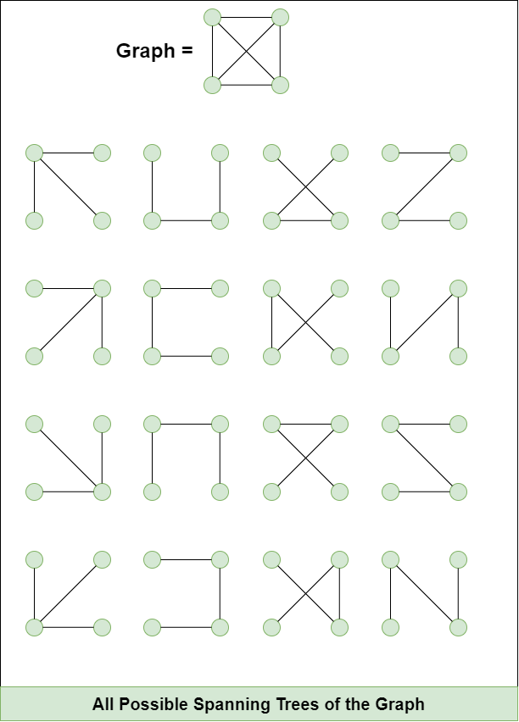

Slide 13
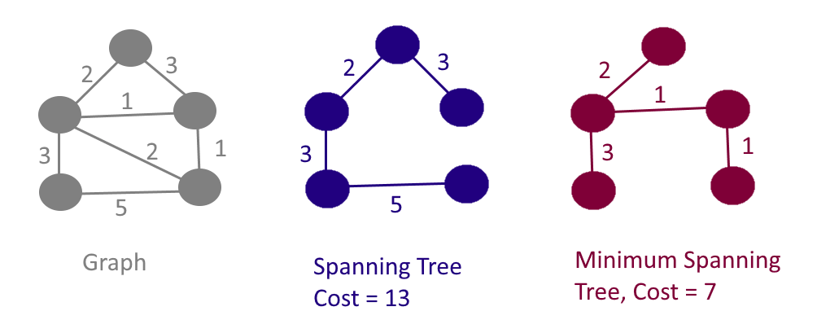
Minimum Spanning Tree

Slide 14
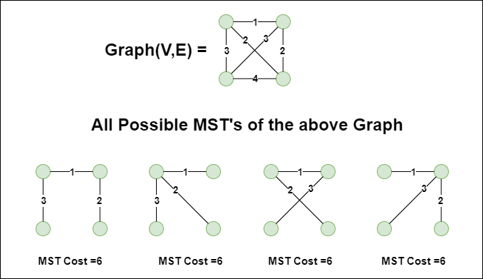
Minimum Spanning Tree

Slide 15
Minimum Spanning Tree
Problem: given a connected, undirected, weighted graph, find a spanning tree using edges that minimize the total weight
6
4
5
9
14
2
10
15
3
8

Slide 16
Prim’s Algorithm
Greedy algorithm like Dijkstra, but instead of shortest path, it picks minimum weight edge to expand MST.
Grows a tree starting from any node.
Steps
Start from a source node, mark it visited.
Push all outgoing edges into a min-heap.
While MST not complete:
  Extract minimum edge (u, v, w).
  If v is not visited, add it to MST and push its edges into heap.
Complexity
Similar to Dijkstra with min-heap.
O(E log V).

Slide 17
Prim’s Algorithm
MST-Prim(G, w, r)
Q = V[G];
for each u ∈ Q
key[u] = ∞;
key[r] = 0;
p[r] = NULL;
while (Q not empty)
u = ExtractMin(Q);
for each v ∈ Adj[u]
if (v ∈ Q and w(u,v) < key[v])
p[v] = u;
key[v] = w(u,v);

Slide 18
Any Questions?

Slide 19
Thank You!

